Slide 1
Chaos, Robust chaos, & applications
Presented by – Indranil Ghosh (@indraghosh314)

Slide 2
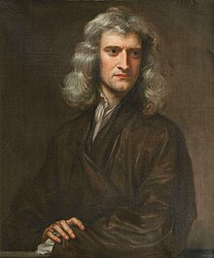
Sir Isaac Newton,
Portrait by Godfrey Kneller
(Source – Wikipedia)

Slide 3
A Dynamical System is a system that evolves in time

Slide 4
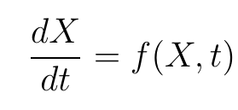
A dynamical system obeys a differential equation or difference equation.
X is the N-dimensional state variables.
f is the evolution rule.
t represents the time.
dt represents the time step.

Slide 5
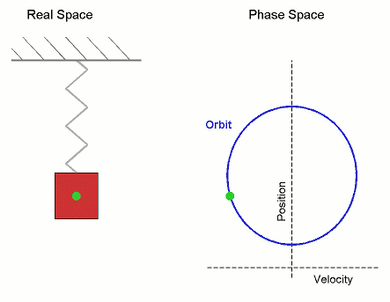
The solution of the dynamical system at time `t’ represents a unique point moving along a curve in the phase space.
Phase space is the space where all the state variables are represented.
Source: Wikipedia

Slide 7
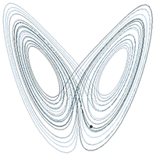
Chaos Theory
Dynamical systems exhibit a wide range of behaviour under slight deviations of the initial conditions.
This makes the long-term behaviour of the system completely unpredictable.
Even though the systems are deterministic in nature.
Source: Wikipedia

Slide 8
The Butterfly effect
The high sensitivity of the dynamical systems to initial conditions is called the butterfly effect.
Every point on the orbit of the chaotic system can be randomly approximated by other points, having notably distinct orbits.

Slide 9
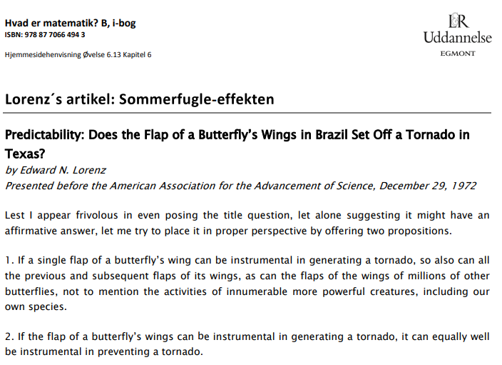

Slide 10
cryptography
Neuroscience
DNA computing
Chaos Theory
Celestial dynamics
Economics
Population dynamics
Finance
Quantum computing

Slide 11
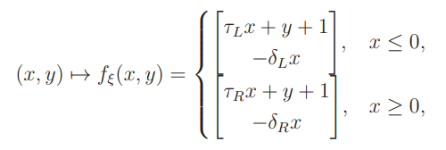
Ph.D. research

Slide 12
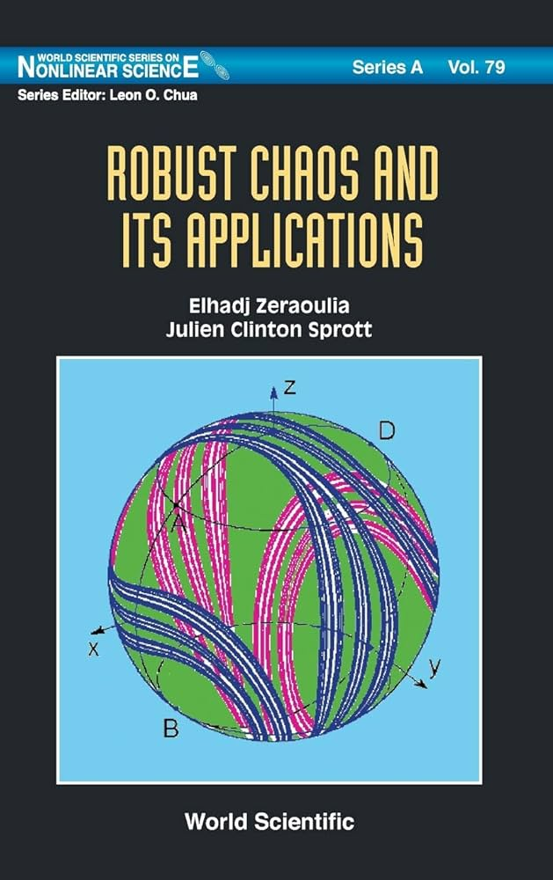
Robust Chaos
Robust chaos refers to the phenomenon that a family of dynamical systems exhibits chaos throughout an open region of parameter space.
This is desirable in practical applications that exploit chaos.
In chaos-based cryptography the key space needs to be chaotic everywhere, otherwise will be vulnerable.
Power converters exhibit advantageous functional characteristics in chaotic regime.

Slide 13
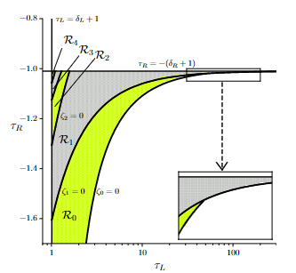
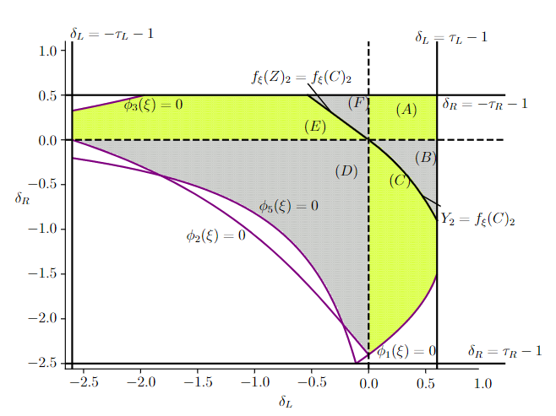

Slide 14
Thank you! Questions?

